Slide 1
Africa Forum on Science, Technology and Innovation (STI) for “Youth Employment, Human Capital Development and Inclusive Growth”
Nairobi, Kenya, April 1-3, 2012
Presentation
By Academician Dato Ir. (Dr.) Lee Yee Cheong, Malaysia
Chairman, Governing Board,
International Science, Technology and Innovation Centre
For South-South Cooperation under the Auspices of UNESCO
(ISTIC)

Slide 2
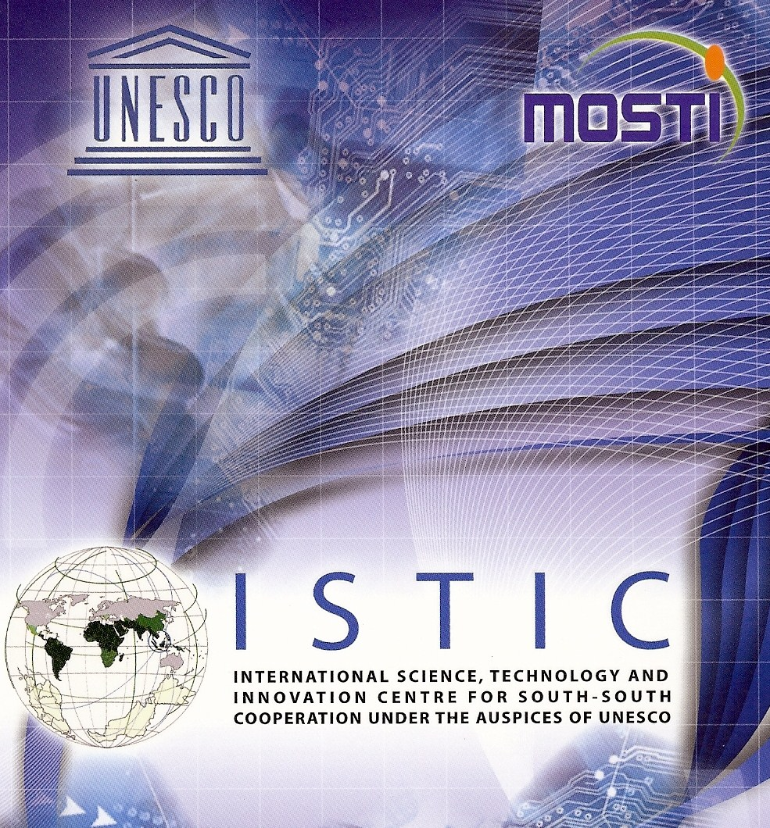

Slide 3
ISTIC
A follow-up of the Second Summit of G77 in Doha, 2005.
UNESCO approached Malaysia to host the Centre in 2006. Malaysian government agreed.
Malaysia-UNESCO Agreement was signed in UNESCO Head Office, Paris on 21 January 2008 to establish the Centre in Kuala Lumpur.
ISTIC was formally launched on 22 May 2008.

Slide 4
Infrastructure Development for Economic Growth and Employment Creation
For developing countries to lift themselves out of poverty and achieve economic development, they need:
Basic infrastructure i.e. roads, ports, airports, schools, housing,water, sanitation, irrigation, clinics, telecommunications, energy etc.
Basic industries, namely small and medium enterprises (SMEs) for supply of goods and services.
Without the above pre-requisites, no industry upscale, no economy uplift and no foreign direct investment (FDI).

Slide 5
Unfortunately there is a desperate shortage in developing countries of infrastructure implementation capacity, both human resource and institutional.
In any developing country, military engineering divisions and units are amongst the best equipped for disaster relief and rehabilitation. This is little difference in disaster relief in the construction of temporary access roads, bailey bridges, jetties, temporary shelters, provision of safe drinking water and emergency electricity supply; and the implementation of basic infrastructure in normal time.
Such invaluable capacity remains idle in a sea of need in developing countries.

Slide 6
Kenya for example suffered from severe drought 2004-2005 and has again been badly affected by the Horn of Africa drought and famine.
As member of the Kenyan National Economic and Social Council (NESC) 2005-2011, I urged the Government to utilise their military engineers to implement water storage for irrigation and access road projects to enhance agricultural productivity and food security.
The Kenyan government is setting up the Kenyan Army Corps of Engineers (KACE) along same lines as the US Army Corps of Engineers to undertake infrastructure projects. Besides USACE, KACE will also learn from the Chinese military engineers.

Slide 7
KACE will actively involve the Kenyan National Youth Service in hands-on skill enhancement.
To confront the more frequent and violent natural disasters due to global warming, developing countries should mobilise their military engineering resources to reforest and undertake engineering projects against sea level rise, flood and drought prevention etc using traditional technologies and local materials.
Developing countries cannot afford the Thames Barrage; surely they can build sea walls and dykes like in 19th century Netherland and well established irrigation knowhow in Egypt.
Therefore, KACE will train the military to enhance disaster relief capabilities. KACE will also upgrade the civil defence capacity of Kenyan communities.

Slide 8
With good infrastructure helping to address the problems of WEHAB (Water, Energy, Health, Agriculture and Biodiversity) and climate change, Small and Medium Enterprises (SME) will spring up all over the country providing meaningful employment for the youth of the nation.
Developing countries whilst building infrastructure must at the same time build up the human capital in repair and maintenance to keep the built infrastructure in good shape.
ISTIC has been conducting training workshops with the Engineering Staff College of India (ESCI) to upgrade the indigenous capacity of engineers and technicians in ESCI Hyderabad, Kuala Lumpur, Nairobi and Abuja under the newly established International Network of Professional Engineers Development Institutes (INPEDI) with ESCI as the global secretariat.
Kenya and Nigeria have signed bilateral MOA with ESCI.

Slide 9
I would also like to mention the following ISTIC initiatives and programmes that are relevant to this Forum:
Inquiry Based Science Education (IBSE)
IBSE is a universal initiative of the global S.E.T community led
by academies of sciences to transform our science and
mathematics education from rote learning to an evidence-based
and hands-on approach that enhances the inquisitiveness and
creativity of children from preschool or kindergarten, through
primary and secondary school, university to career based lifelong
learning. This will be the foundation of an innovative society.
ISTIC’s partner is La Main a la pate (LAMAP) of the French Academy of Sciences. LAMAP has dramatically helped to increase science education from 3% of French primary schools in 1996 to more than 50% currently. LAMAP has spread to around 50 countries.

Slide 10


Slide 11
Technopreneur Development
This is an ISTIC priority programme to help STI researchers to commercialise the fruits of their research. ISTIC’s partner is USAINS of the University Science Malaysia
This programme includes an annual ISTIC/TWAS competition to document the most innovative STI research projects in the developing world with prizes of US$ 5000.0; 3000.0 and 2000.0.

Slide 12
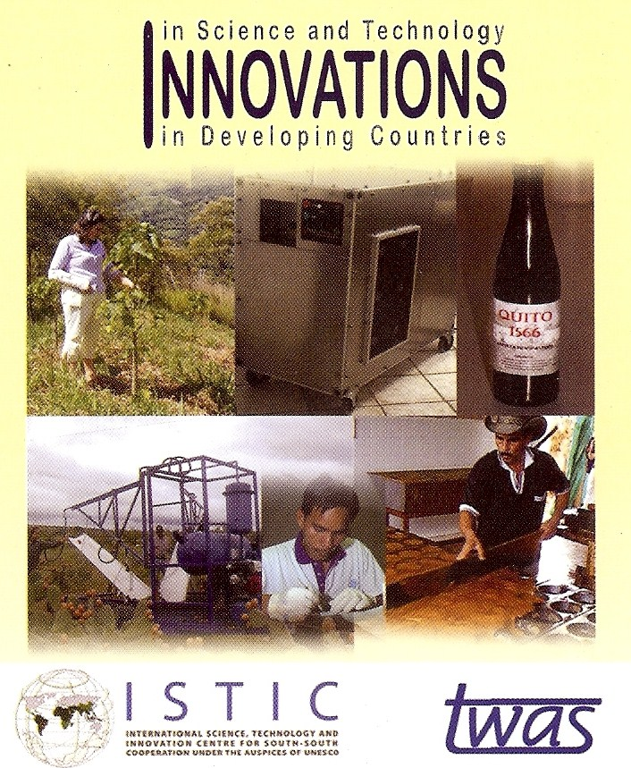

Slide 13
Institute of Energy Policy and Research (IEPRe)
National STI policy formulation is another priority ISTIC agenda.
Personally I find most national STI policy documents in developing countries tend to be all “song and dance”. I prefer to focus on WEHAB individually.
As a start, with the help of Dr. Rajendra K. Pachauri, Chairman, IPCC and his TERI/TERI University in New Delhi, IEPRe has been established in the National Energy University Malaysia to be the indigenous energy and climate change think tank. Dr. Pachauri and I will explore the setting up of IEPRe in Future University, Sudan later this year.
Later this year, ISTIC with the Future University Sudan and relevant Ministries in Sudan will be conducting African training workshops in IBSE with LAMAP and Technopreneur Development with funding from Islamic Development Bank in Khartoum .

Slide 14
Proposed African Academy of Engineering and Technology (AfriAET)
This is my own initiative. Modeled on the ASEAN Academy of Engineering and Technology (AAET), AfriAET aims to be top STI think tank for Africa.
Membership Guideline: one third government, one third academia and one third industry.
The Rt. Hon. Raila A Odinga, an eminent engineer and Prime Minister of Kenya is AfriAET Patron.
The Protem Committee is working hard to get nominations of Founding Fellows to launch AfriAET in Nairobi, November this year.

