Slide 1
Moving Up The E&E Value Chain
AN OVERVIEW OF TRIPLE HELIX PROGRAMS
IN THE NORTHERN CORRIDOR OF MALAYSIA
for the
AFRICA FORUM ON SCIENCE, TECHNOLOGY AND INNOVATION
FOR YOUTH EMPLOYMENT, HUMAN CAPITAL DEVELOPMENT, AND INCLUSIVE GROWTH
|NAIROBI, KENYA| APRIL 1-3, 2012
by
Chris Tan, Director E&E / Innovation
Performance Management & Delivery Unit,
Prime Minister’s Office, MALAYSIA

Slide 2
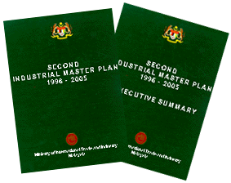
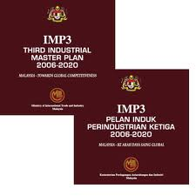
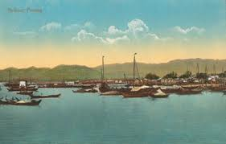








A Condensed History Of E&E in Penang
Pre-1969
1969
1971
1980
1990
2000
2010
2020+
Value
Added
Biz Services 2.0
Content
Global Branding
Free Port Status
Revoked
Biz Services
Chip Design
Product Devt
Foundry
Mfg Svcs 2.0
Bayan Lepas
Free Trade Zone
Established
Assy/Test Tech Devt
Optimisation
Test
Assembly
Major trading post on Malacca Straits
Growth enabled by free port status
INDUSTRIAL
MASTER
PLANNING
Industrial Masterplan 2
Industrial Masterplan 3
VERTICAL
IMPLEMENTATION
REGIONAL
(2007)

Slide 3
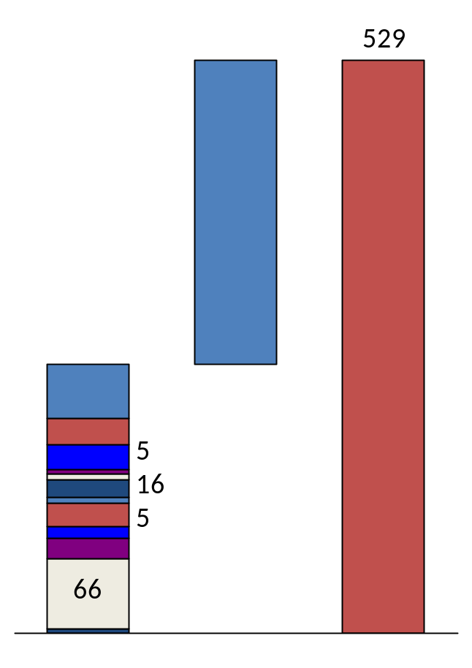
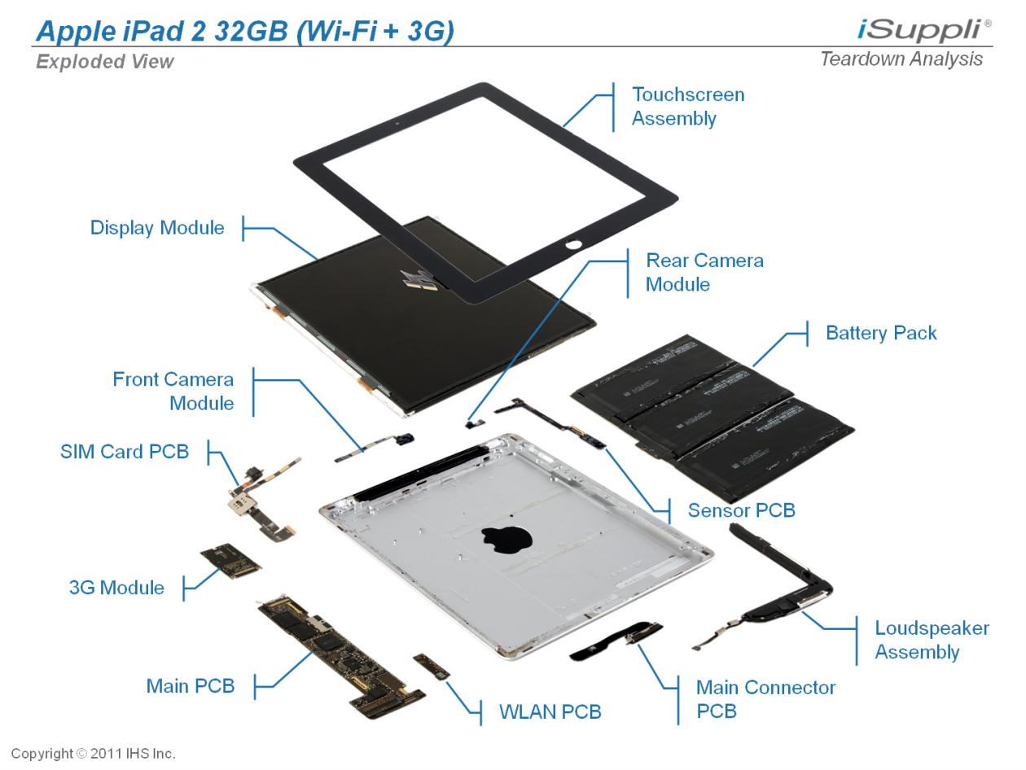
The Need To Move Up The Value Chain :
A Simple Example
>
Display
Touchscreen
281
Battery
Camera
Wifi/GPS
248
NAND
SDRAM
50
Processor (A5)
25
22
6
BB + Transcevier
Non-electronic
22
10
Other
19
Supporting Materials
4
“Product”
Total Cost
Profit Margins
Retail Price
Value Creation in E&E
“Device”
Component
Assembly cost for most popular
tablet computer : US5.80
Assy of components : Similar
Value in design, fabrication, S&M
Design
MRO
Mfg Tech/Svcs
Sales
Assembly
Fabrication
Dist’n
Assembly
Assembly

Slide 4
The Human Capital Landscape :
Diversity of Stakeholders & Imperatives
Bridging Universities and Industry
Support for human capital and Special Projects
MNC
LLC/SME
MANPOWER
Moving
Up The
Value Chain
And Towards
High Income
Economy
Facilitating SME
Innovation
Diversification of
activity base & R&D
Upgrading of human capital
Enhancement of
employability
Stakeholders
Source : Northern Corridor Implementation Authority (NCIA)

Slide 5
People Development Initiatives:
Industry-Govt Partnerships in Penang
Collaboration for Research in Science, Engineering & Tech (CREST)
Joint Research Programs in Advanced Manufacturing Tech
MNC
LLC
SME
MANPOWER
E&E Centres of Excellence (COE)
Shared Services To Enable SME Innovation
Shared Services To Enable SME Innovation
Penang Skills Development Centre
NATIONAL EDUCATION PLATFORM
(Basic Education / Fundamental Research)
Source : Northern Corridor Implementation Authority (NCIA)

Slide 6
Profiles Of Our Initiatives
 | PSDC (1980) | E&E COE (2009) | CREST (2012)
Function | Basic manufacturing skills : mechatronics, machining, etc | Shared design & devt tools, consulting, training etc for SMEs | Joint R&D between MNCs & unis as post-grad training platform
Stakeholders | All companies | Set up by NCIA; Initial targets – IC design, test tech, M&E companies | Set up by NCIA; initial targets –established mfg houses with advanced technology needs
Structure | NGO; Registered Society | Operating company appointed by open tender | Company limited by guarantee; special purpose vehicle by NCIA
Governance | Professional Training Management Team; Mgmt Committee elected from among member companies | Management Team with design/devt experience; Mgmt Comm & Industry Advisory Panel | Management Team with direct mfg experience; Mgmt Comm comprising core startup members to provide iniitial steering.
Funding | Training fees, consultancy, membership dues, govt grants, donated equipment | Seed capital from NCIA, training fees, consultancy, tool provision, outsourced design services | Seed capital from NCIA, Initial operating funds from Federal Govt; membership fees

Slide 7
Looking Back :
Things we could have done better
FDI vs GNI
Follow through strategy vs initial success
Exit Strategy
Deepening roots
Integration between government agencies
  Planning, Promotion, Execution

Slide 8

Thank You

